Slide 1
Results comparison: 1 magnet configuration, 4 3-axis sensors
Maximize the reciprocal condition number
Maximize the minimum singular value of J = [Jp, Jo]
Maximize the reciprocal condition number + minimum singular value of J = [Jp,Jo] (2 objectives)
Maximize the minimum singular values of Jp and Jo, respectively (2 objectives)
Maximize the reciprocal condition number + minimum singular values of Jp and Jo (3 objectives)
25.06.2024
1
Notes:
The one magnet configuration is position at (0;0;0) and orienting upward.

Slide 2
Results comparison: 1 magnet configuration, 4 3-axis sensors
Maximize the reciprocal condition number
Reciprocal condition number = 0.2022
Minimum(5th) singular value of J = [Jp, Jo] = 4.1e-7
Minimum singular value of Jp = 8.3e-7
Minimum(2nd) singular value of Jo = 1.4e-6
Maximize the minimum(5th) singular value of J = [Jp, Jo]
Reciprocal condition number = 0.1380
Minimum(5th) singular value of J = [Jp, Jo] = 8.5e-7
Minimum singular value of Jp = 4.2e-6
Minimum(2nd) singular value of Jo = 3.5e-6
Maximize the reciprocal condition number + minimum singular value of J
25.06.2024
2

Slide 3
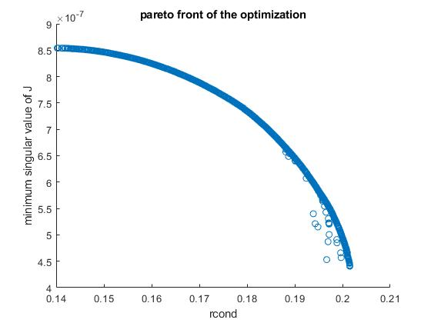
Results comparison: 1 magnet configuration, 4 3-axis sensors
Maximize the reciprocal condition number + minimum singular value of J
Result for 2
Result for 1
25.06.2024
3
Notes:
The pareto front contains the results that optimizes only one objective.

Slide 4
Results comparison: 1 magnet configuration, 4 3-axis sensors
Maximize the minimum singular value of Jp and Jo (2 objectives)
The optimization push the sensors to the origin
Reciprocal condition number: ~0
Minimum singular value of J: ~0
Minimum singular value of Jp: 6.6e-6
Minimum singular value of Jo: 4.4e-6
Note: in this case, maximizing these 2 objectives are not competing.
Maximize the reciprocal condition number and the minimum singular values of Jp and Jo (3 objectives)
25.06.2024
4
Notes:
In this case, the two objectives are not competing. They can be simultaneously maximize. The optimization gives one solution.

Slide 5
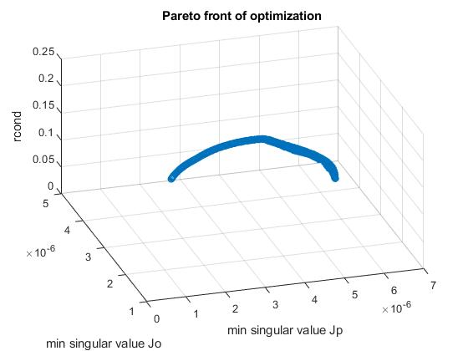
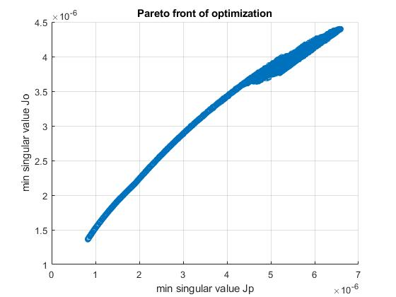
Results comparison: 1 magnet configuration, 4 3-axis sensors
Maximize the reciprocal condition number and the minimum singular values of Jp and Jo (3 objectives)
Projected on X-Y plane
Result for 4
Result for 4
25.06.2024
5
Notes:
The rcond increases first than decreases. The edge of this pareto front is the result for 4, where only the minimum singular values are optimized. The right plot is the left plot projected on X-Y plane.

Slide 6
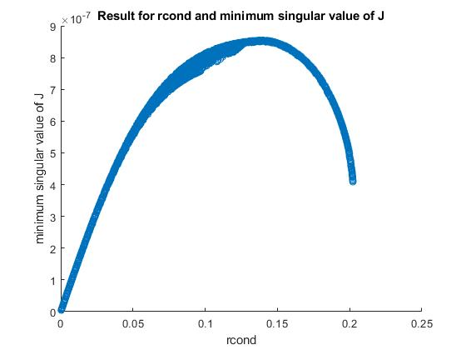
Results comparison: 1 magnet configuration, 4 3-axis sensors
Maximize the reciprocal condition number and the minimum singular values of Jp and Jo (3 objectives)
Result from 5, but plotting minimum singular value of J versus the condition number
It’s part of the solution of 3
25.06.2024
6

Slide 7
Results comparison: 3 magnet configuration, 4 3-axis sensors
Maximize the min reciprocal condition number
Maximize the min minimum singular value of J = [Jp, Jo]
Maximize the min reciprocal condition number + min minimum singular value of J = [Jp,Jo] (2 objectives)
Maximize the min minimum singular values of Jp and Jo, respectively (2 objectives)
Maximize the min reciprocal condition number + min minimum singular values of Jp and Jo (3 objectives)
25.06.2024
7
Notes:
The 3 magnet configuration are position at (0,0,0) and 3 orientations like a coordinate axis.

Slide 8
Results comparison: 3 magnet configuration, 4 3-axis sensors
Maximize the min reciprocal condition number
Min rcond: 0.2022
Min singular value of J = [Jp, Jo]: 4.2e-7
Min singular value of Jp: 8.1e-7
Min singular value of Jo: 1.3e-6
Maximize the min minimum singular value of J = [Jp, Jo]
Min rcond: 0.1375
Min singular value of J = [Jp, Jo]: 8.5e-7
Min singular value of Jp: 2.0e-6
Min singular value of Jo: 3.3e-6
Maximize the min reciprocal condition number + min minimum singular value of J = [Jp,Jo] (2 objectives)
25.06.2024
8

Slide 9
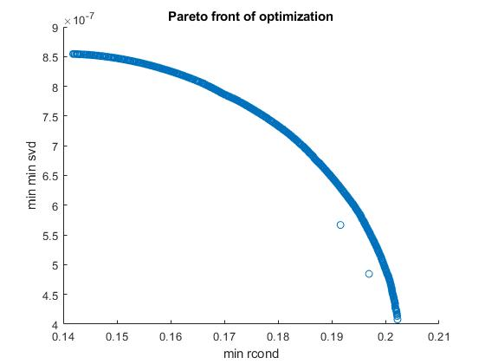
Results comparison: 3 magnet configuration, 4 3-axis sensors
Maximize the min reciprocal condition number + min minimum singular value of J = [Jp,Jo] (2 objectives)
Result for 2
Result for 1
25.06.2024
9

Slide 10
Results comparison: 3 magnet configuration, 4 3-axis sensors
Maximize the min reciprocal condition number + min minimum singular value of J = [Jp,Jo] (2 objectives)
1 config solution
Compared to 1 config solution.
Because the min reciprocal condition number and min minimum singular values happen to be at the “upward” configuration. The results are the same.
25.06.2024
10

Slide 11
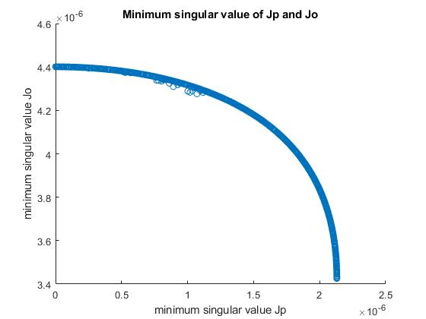
Results comparison: 3 magnet configuration, 4 3-axis sensors
Maximize the min minimum singular values of Jp and Jo, respectively (2 objectives)
1 config solution
The optimization push the sensors to the origin
Reciprocal condition number: ~0
Minimum singular value of J: ~0
Minimum singular value of Jp: 6.6e-6
Minimum singular value of Jo: 4.4e-6
Compared to 1 config solution. The two objectives become competing in the 3 configurations case.
25.06.2024
11

Slide 12
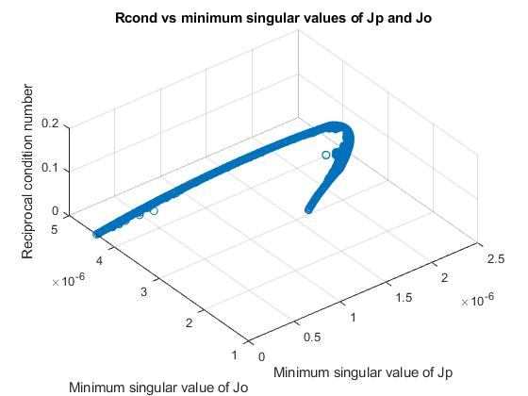
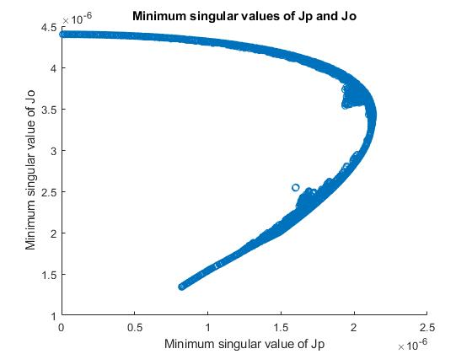
Results comparison: 3 magnet configuration, 4 3-axis sensors
Maximize the min reciprocal condition number + min minimum singular values of Jp and Jo (3 objectives)
1 config solution
Compared to 1 config
Projected on X-Y plane
Result for 4
25.06.2024
12
Notes:
The result for 4 is also part of the result for 5. The rcond keeps increasing along the trajectory.

Slide 13
Results comparison: 1 magnet configuration, 12 1-axis sensors
Maximize the reciprocal condition number
Maximize the minimum singular value of J = [Jp, Jo]
Maximize the reciprocal condition number + minimum singular value of J = [Jp,Jo] (2 objectives)
Maximize the minimum singular values of Jp and Jo, respectively (2 objectives)
Maximize the reciprocal condition number + minimum singular values of Jp and Jo (3 objectives)
25.06.2024
13

Slide 14
Results comparison: 1 magnet configuration, 12 1-axis sensors
Maximize the reciprocal condition number
Reciprocal condition number = 0.4894
Minimum singular value of J = [Jp, Jo] = 5.3e-7
Minimum singular value of Jp = 7.4e-7
Minimum singular value of Jo = 9.2e-7
Maximize the minimum singular value of J = [Jp, Jo]
Reciprocal condition number = 0.1380
Minimum singular value of J = [Jp, Jo] = 1.3519e-6
Minimum singular value of Jp = 1.3596e-6
Minimum singular value of Jo = 1.3724e-6
Maximize the reciprocal condition number + minimum singular value of J = [Jp,Jo] (2 objectives)
25.06.2024
14

Slide 15
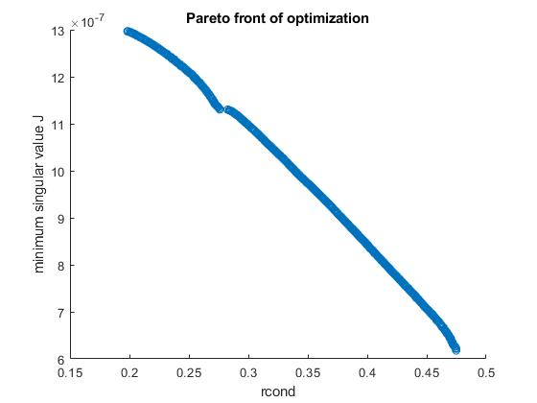
Results comparison: 1 magnet configuration, 12 1-axis sensors
Maximize the reciprocal condition number + minimum singular value of J
Result for 2
Result for 1
25.06.2024
15

Slide 16
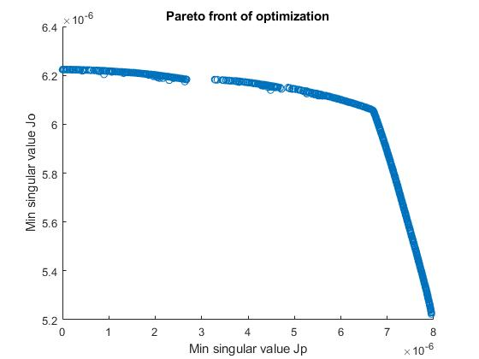
Results comparison: 1 magnet configuration, 12 1-axis sensors
Maximize the minimum singular value of Jp and Jo (2 objectives)
The two objectives becomes competing when using 12 1-axis sensors
Minimum singular value of Jp: 6.6e-6
Minimum singular value of Jo: 4.4e-6
Compared to
3-axis solution
25.06.2024
16

Slide 17
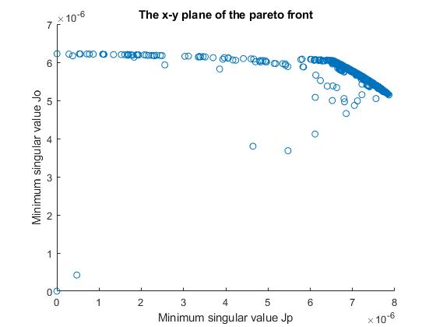
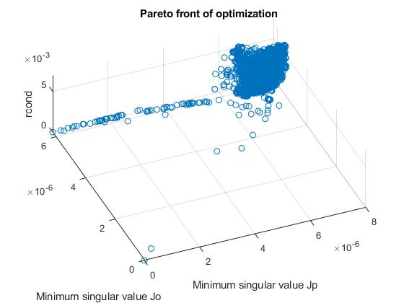
Results comparison: 1 magnet configuration, 12 1-axis sensors
Maximize the reciprocal condition number and the minimum singular values of Jp and Jo (3 objectives)
Projected on X-Y plane
Same Result as 4
25.06.2024
17

Slide 18
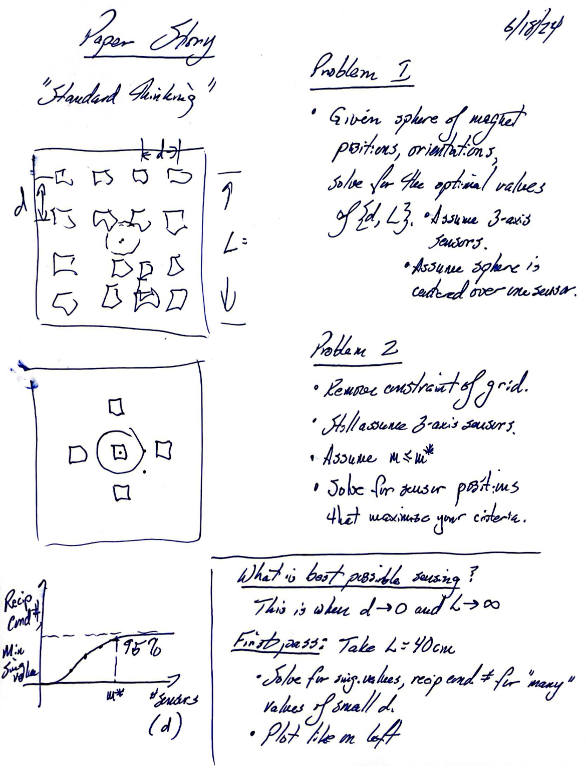
Finding a baseline for the optimized sensor grid
Pierre’s note
25.06.2024
18

Slide 19
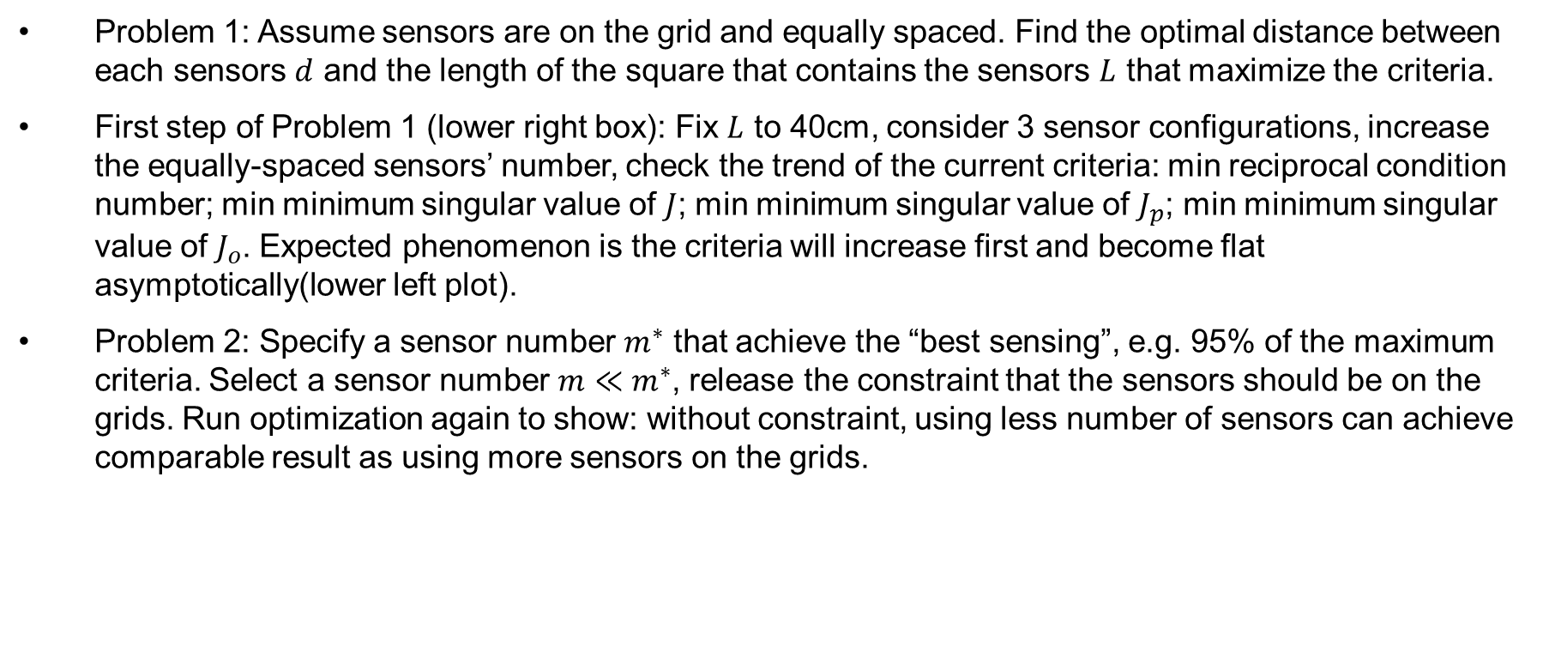
Finding a baseline for the optimized sensor configuration
Problem 1: Assume sensors are on the grid and equally spaced. Find the optimal distance between each sensors $d$ and the length of the square that contains the sensors $L$ that maximize the criteria.
First step of Problem 1 (lower right box): Fix $L$ to 40cm, consider 3 sensor configurations, increase the equally-spaced sensors’ number, check the trend of the current criteria: min reciprocal condition number; min minimum singular value of $J$; min minimum singular value of $J_{p}$; min minimum singular value of $J_{o}$. Expected phenomenon is the criteria will increase first and become flat asymptotically(lower left plot).
Problem 2: Specify a sensor number $m^{∗}$ that achieve the “best sensing”, e.g. 95% of the maximum criteria. Select a sensor number $m≪m^{∗}$, release the constraint that the sensors should be on the grids. Run optimization again to show: without constraint, using less number of sensors can achieve comparable result as using more sensors on the grids.
25.06.2024
19

Slide 20

Finding a baseline for the optimized sensor configuration
First step of problem 1: Fix $L$ to 40cm, consider 3 sensor configurations, increase the equally-spaced sensors’ number, check the trend of the current criteria: min reciprocal condition number of $J$; min minimum singular value of $J$; min minimum singular value of $J_{p}$; min minimum singular value of $J_{o}$. Expected phenomenon is the criteria will increase first and become flat asymptotically(lower left plot).
The sensor space is square. Starting from 1 sensor at the center; to 2 sensors on a row and 2 rows; 3 sensors on a row and 3 rows, and so on. The sensor configurations are like:
4 sensors
9 sensors
16 sensors
…
25.06.2024
20

Slide 21
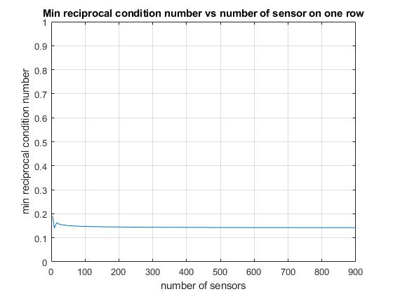
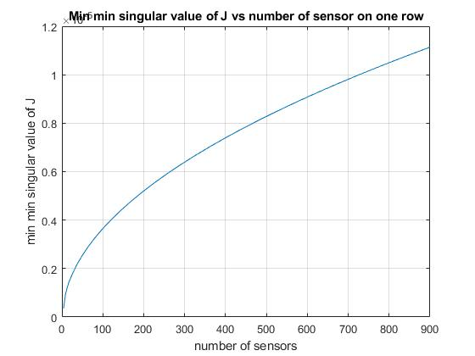
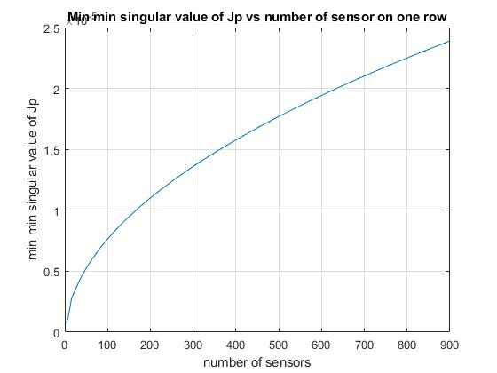

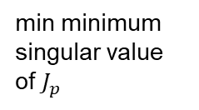
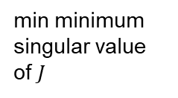
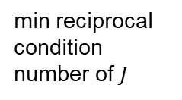
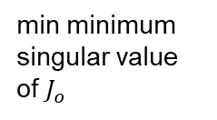
Finding a baseline for the optimized sensor configuration
The 4 criteria change accordingly as follow, the plots show the criteria’s trend from 2*2=4 sensors to 30*30=900 sensors:
min reciprocal condition number of $J$
min minimum singular value of $J$
min minimum singular value of $J_{p}$
min minimum singular value of $J_{o}$
25.06.2024
21

Slide 22
Finding a baseline for the optimized sensor configuration
The reciprocal condition number is already maximum at 4 sensors, then approach 0.14 asymptotically.
The 3 minimum singular values increases monotonically. Not as expected.
It can be proved, to some extend, that the minimum singular values will increase as increasing number of sensors.
25.06.2024
22

Slide 23
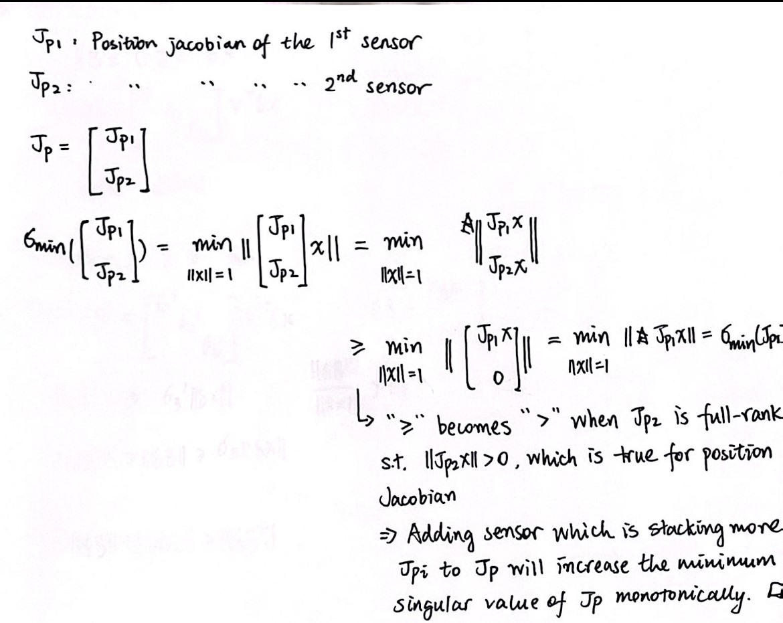
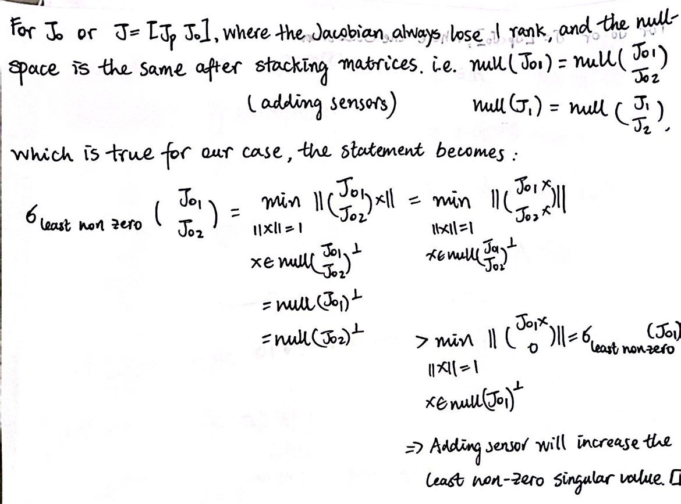
Proof of increasing minimum singular value when adding sensor
The above proofs show that, while keeping the original sensor location, adding new sensors at other location will monotonically increase the minimum singular value of the Jacobian.
In our case, it means the minimum singular value of the 4(2*2) sensor configuration is smaller than 9(3*3) sensors configuration, which is again smaller than 25(5*5) sensors configuration, and so on; The minimum value of the 16(4*4) sensor configuration is smaller than that of the 49(7*7) sensor configuration, and so on; and it extends to other number of sensor.
: old sensor location
: old sensor location
25.06.2024
23

Slide 24
Interpretation and possible solution
The minimum singular value gives a lower bound on the output’s norm given the input’s norm. Intuitively, adding more sensor will enlarge the dimension of the output, and its norm. So the minimum singular value also increases.
Possible solution: normalize the singular value by the number of sensor, so the effect of adding number of sensor is cancel out.
25.06.2024
24

Slide 25
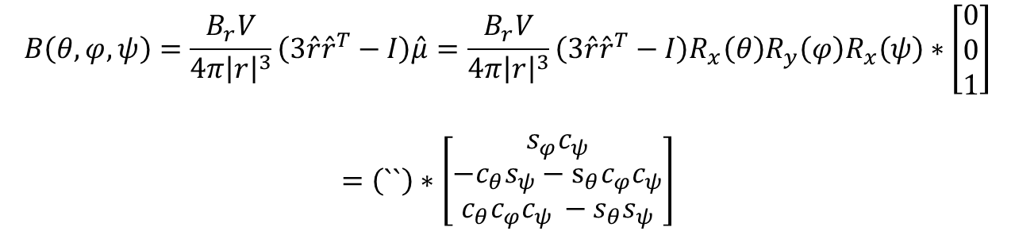
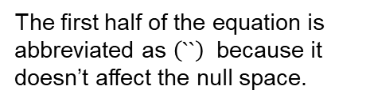
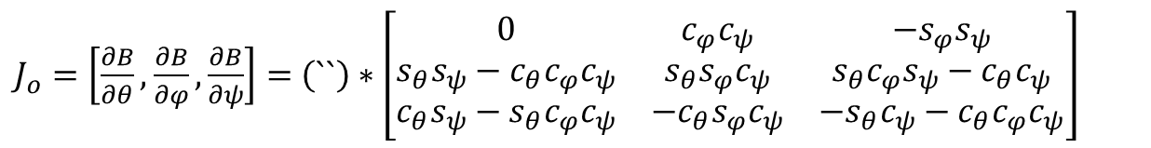
One observation I cannot understand
Observation: The null-space of the orientation Jacobian is not a rotation around z-axis.
$$B\left(θ,φ,ψ\right)=\frac{B_{r}V}{4π{\left|r\right|}^{3}}\left(3\hat{r}{\hat{r}}^{T}−I\right)\hat{μ}=\frac{B_{r}V}{4π{\left|r\right|}^{3}}\left(3\hat{r}{\hat{r}}^{T}−I\right)R_{x}\left(θ\right)R_{y}\left(φ\right)R_{x}\left(ψ\right)∗\left[\begin{matrix}0 \\ 0 \\ 1\end{matrix}\right]$$
$$=\left(``\right)∗\left[\begin{matrix}s_{φ}c_{ψ} \\ −c_{θ}s_{ψ}−s_{θ}c_{φ}c_{ψ} \\ c_{θ}c_{φ}c_{ψ }−s_{θ}s_{ψ}\end{matrix}\right]$$
The first half of the equation is abbreviated as $\left(``\right)$ because it doesn’t affect the null space.
$J_{o}=\left[\frac{∂B}{∂θ},\frac{∂B}{∂φ},\frac{∂B}{∂ψ}\right]=$ $\left(``\right)∗\left[\begin{matrix}0 & c_{φ}c_{ψ} & {−s}_{φ}s_{ψ} \\ s_{θ}s_{ψ}−c_{θ}c_{φ}c_{ψ} & {s_{θ}s_{φ}c}_{ψ} & s_{θ}c_{φ}s_{ψ}−c_{θ}c_{ψ} \\ c_{θ}s_{ψ}−s_{θ}c_{φ}c_{ψ} & −c_{θ}s_{φ}c_{ψ} & {−s}_{θ}c_{ψ}−c_{θ}c_{φ}c_{ψ}\end{matrix}\right]$
25.06.2024
25
Notes:
The first equation is the magnetic field generated by a magnetic dipole. The dipole’s direction is represented by 3 angles, which are redundant. The second equation is its corresponding jacobian.

Slide 26

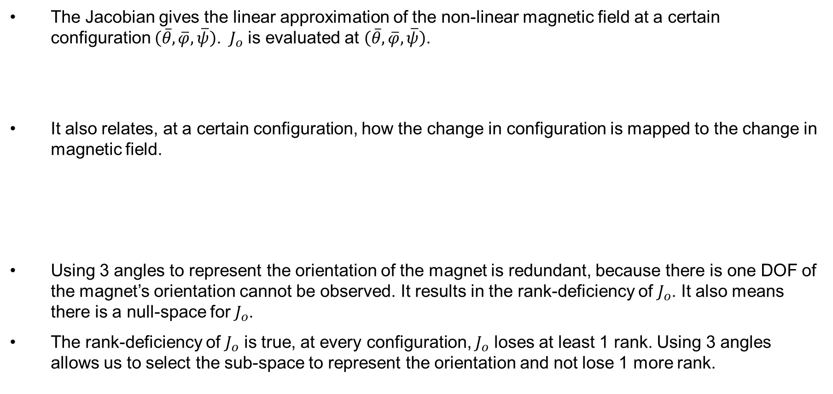

One observation I cannot understand
The Jacobian gives the linear approximation of the non-linear magnetic field at a certain configuration $\left(\overline{θ},\overline{φ},\overline{ψ}\right)$. $J_{o}$ is evaluated at $\left(\overline{θ},\overline{φ},\overline{ψ}\right)$.
It also relates, at a certain configuration, how the change in configuration is mapped to the change in magnetic field.
Using 3 angles to represent the orientation of the magnet is redundant, because there is one DOF of the magnet’s orientation cannot be observed. It results in the rank-deficiency of $J_{o}$. It also means there is a null-space for $J_{o}$.
The rank-deficiency of $J_{o}$ is true, at every configuration, $J_{o}$ loses at least 1 rank. Using 3 angles allows us to select the sub-space to represent the orientation and not lose 1 more rank.
$${B\left(θ,φ,ψ\right)≈B\left(\overline{θ},\overline{φ},\overline{ψ}\right)+J}_{o}\left(\overline{θ},\overline{φ},\overline{ψ}\right)(\left[\begin{matrix}θ \\ φ \\ ψ\end{matrix}\right]−\left[\begin{matrix}\overline{θ} \\ \overline{φ} \\ \overline{ψ}\end{matrix}\right])$$
$${B\left(θ,φ,ψ\right)−B\left(\overline{θ},\overline{φ},\overline{ψ}\right)≈J}_{o}\left(\overline{θ},\overline{φ},\overline{ψ}\right)∗(\left[\begin{matrix}θ \\ φ \\ ψ\end{matrix}\right]−\left[\begin{matrix}\overline{θ} \\ \overline{φ} \\ \overline{ψ}\end{matrix}\right])$$
$${δ_{B}\left(\overline{θ},\overline{φ},\overline{ψ}\right)≈J}_{o}\left(\overline{θ},\overline{φ},\overline{ψ}\right)∗δ_{angle}\left(\overline{θ},\overline{φ},\overline{ψ}\right)$$
25.06.2024
26

Slide 27
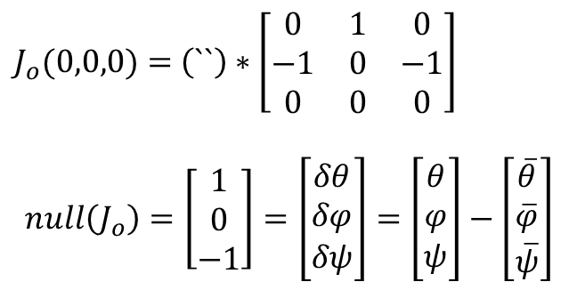
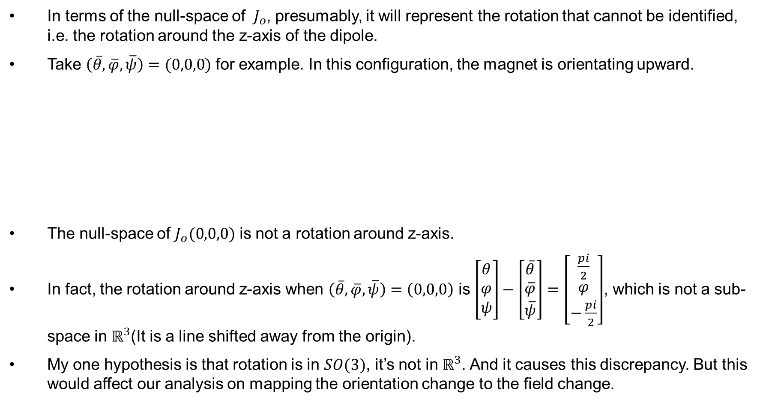
One observation I cannot understand
In terms of the null-space of $J_{o}$, presumably, it will represent the rotation that cannot be identified, i.e. the rotation around the z-axis of the dipole.
Take $\left(\overline{θ},\overline{φ},\overline{ψ}\right)=(0,0,0)$ for example. In this configuration, the magnet is orientating upward.
The null-space of $J_{o}(0,0,0)$ is not a rotation around z-axis.
In fact, the rotation around z-axis when $\left(\overline{θ},\overline{φ},\overline{ψ}\right)=\left(0,0,0\right)$ is $\left[\begin{matrix}θ \\ φ \\ ψ\end{matrix}\right]−\left[\begin{matrix}\overline{θ} \\ \overline{φ} \\ \overline{ψ}\end{matrix}\right]=\left[\begin{matrix}\frac{pi}{2} \\ φ \\ −\frac{pi}{2}\end{matrix}\right]$, which is not a sub-space in $ℝ^{3}$(It is a line shifted away from the origin).
My one hypothesis is that rotation is in $SO(3)$, it’s not in $ℝ^{3}$. And it causes this discrepancy. But this would affect our analysis on mapping the orientation change to the field change.
$J_{o}(0,0,0)=$ $\left(``\right)∗\left[\begin{matrix}0 & 1 & 0 \\ −1 & 0 & −1 \\ 0 & 0 & 0\end{matrix}\right]$
$$null\left(J_{o}\right)=\left[\begin{matrix}1 \\ 0 \\ −1\end{matrix}\right]=\left[\begin{matrix}δθ \\ δφ \\ δψ\end{matrix}\right]=\left[\begin{matrix}θ \\ φ \\ ψ\end{matrix}\right]−\left[\begin{matrix}\overline{θ} \\ \overline{φ} \\ \overline{ψ}\end{matrix}\right]$$
25.06.2024
27

